Slide 1
Services
OBI Workshop, Philadelphia 2011
Carlo Torniai, Matt Brush

Slide 2
Outline
Background
What is currently in OBI
What needs to be done

Slide 3
Service design pattern
Discussion and decision at San Diego workshop

Slide 4
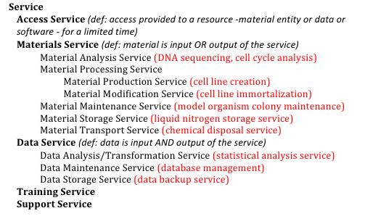
Service hierarchy
A process-based approach that uses the nature of the process performed by the service

Slide 5
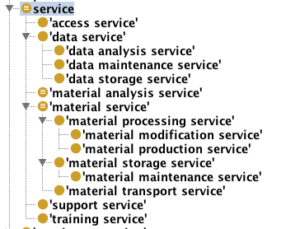

What is currently in OBI
Hierarchy with textual definitions
Some logical definitions

Slide 6
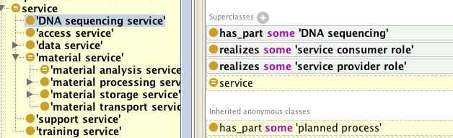
What is currently in OBI

Slide 7
Issues / Open questions
The current service definition doesn't' allow a proper classification according to specified input and output:
‘DNA sequencing service’ isn’t correctly classified under material analysis service

Slide 8
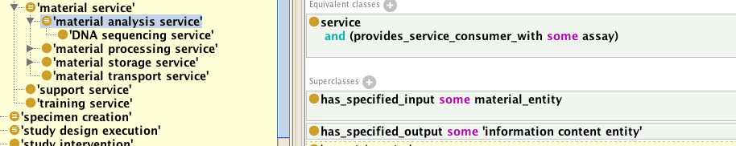
Issues / Open questions
In order to have ‘DNA sequencing service” classifying correctly under ‘material analysis service’ we can:
- define provides_service_consumer_with as non transitive property of has_part
- define 'material analysis service’
as follows

Slide 9
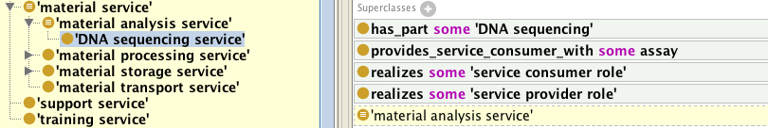
Issues / Open questions
‘DNA sequencing service’ can be defined as follows and will be classified as ‘material analysis service’

Slide 10
Issues / Open questions
1) There is no current logical definition of access service. We can define ‘provides_access_to’ as shortcut of participants in a process
2) Should we define for each service the related process (if not present) and the related planned objective?
Material maintenance and material storage
Currently material storage is defined as having part some storage but storage has material maintenance as object specification. Not necessarily a material maintenance is needed in a storage process. We should fix this to capture the difference between storage and maintenance

Slide 11
What needs to be done
Solve questions above
Add logical definitions
All service subclass?
MIREOT OBI service classes in eagle-i
What else should be done in light of the grant?

Slide 12
Backup
Notes:
Email thread
RDMS:
Permission and Consent
Architecture not truly ontology based.
The goal is to improve the architecture to improve the RPMS to be more ontologically oriented
'material analysis service'
as
service
and (provides_service_consumer_with some (has_specified_input some material_entity))
and (provides_service_consumer_with some (has_specified_output some 'information content entity'))
I am not sure I completely understand. Just to make sure, we are on the same page, you should also be able to keep the initial design pattern, just substituting has_part with provides... :
'material analysis service'
as
service
and (provides_service_consumer_with some (has_specified_input some material_entity))
and (provides_service_consumer_with some (has_specified_output some 'information content entity'))
I just thought 'assay' will be easier to understand.
- Bjoern
Bjorn I agree that what you propose works.
I wish we could do it in a more explicit and cleaner way, but we need to live with the limitations of OWL.
Anyway let's plan to briefly discuss next Tue. I will leave for Europe next Wed.
Cheers,
Carlo
On Aug 9, 2011, at 5:24 PM, Bjoern Peters wrote:
I agree we should discuss. However, I still believe what I say works, as assay is defined as having input material entity and output information content entity, while material transformation is defined as having material input and material output. The problem with the definition you give below is that the 'has part' you are using cannot be used for an N&S definition as e.g. DNA sequencing that has as a part a sample transformation step would make the service classify as a material transformation service.
Unfortunately I won't have time for a call before next Tuesday (NIH site visit coming up, and I really need to prepare my presentation).
- Bjoern
I've understood your point Bjoern but in this way we don't *actually* implement/realize the classification of services according to their input and output.
If we 'material analysis service'
as
service
and (has_part some (has_specified_input some material_entity))
and (has_part some (has_specified_output some 'information content entity'))
'DNA sequencing service' defined as:
has_part some 'DNA sequencing'
realizes some 'service consumer role'
realizes some 'service provider role'
is classify correctly under 'material analysis service' and the classification is explicitly based on the inout and output.
The issue here is that the defined class for 'material analysis service' is probably too loose.
Anyway we can set up some time to briefly discuss this and the other points with you and Jie and come up with a proposal to present to everybody.
Carlo
On Aug 9, 2011, at 4:42 PM, Bjoern Peters wrote:
The additional property "provices service consumer with" (non transitive) helps in that we can use it in N&S definitions. We can define material analysis services N&S as service and "provides service consumer with" some assay. The DNA sequencing service would be N&S defined as service and "provides service consumer with" some DNA sequencing assay. Similar we can define a 'material transformation service' as service and providing service consumer with some material transformation. It needs to be a non-transitive sub-property of has_part, as most assays have 'material transformations' as parts, and therefore every material analysis service would also be inferred as a material transformation service.
- Bjoern
Dr. Carlo Torniai
Ontologist
Networking Research Resources
Oregon Health & Science University
torniai@ohsu.edu
Phone: 503 418 2499
skype: ctorniai
On Aug 9, 2011, at 9:20 AM, Jie Zheng wrote:
Hi Carlo,
Just look the details of it.
For me the axioms of 'service' is weird. Because
'service' = 'planned process' and ((realizes some 'service consumer
role') and (realizes some 'service provider role'))
and 'service' has_part 'planned process'.
I don't know why we add 'service' has_part 'planned process'. I think
this is what Bjoern said recursive. I removed the axiom "has_part
'planned process'" from service. 'DNA sequencing service' is still
inferred as a subclass of 'service'.
Oh yes I think that's fine probably it's something that was left there.
If we want more specific, we can
define a property 'provides service consumer with'.
So the problem here is that to classify DNA sequencing service has a material analysis service and have the hierarchy based on input and output it's not straightforward.
However, I have some
questions about how to define it.
1) Can we define a non-transitive property as a subproperty of a
transitive property
2) Why is it a non-transitive property? It relates to granularity. If I
define 'DNA sequencing' including reagent preparation (part of DNA
sequencing), I can say it also provides service consumer with reagent
preparation. I think it should be a transitive property.
I think we can set a call to discuss about it.
Yes we need to discuss about it because I dont' see this additional property solve the issue of classification.
But we shoudl talk about it.
About 4) Material maintenance and material storage. I think they are
difference. As you said, material maintenance do not need a storage
process. However, storage is an approach for material maintenance. If
you check the inferred hierarchy, storage is a subclass of 'material
maintenance' which has another subclass 'maintaining cell culture'. I
think it looks fine.
My point is that material maintenance is usually more than storage and may or may not imply necessarily storage.
And since storage and maintenance in terms of process are mixed up I wanted to discuss about it.
My point is that storage is not necessarily maintenance (but here i think it comes down to the definition of maintenance).
Anyway again something to discuss about it.
Cheers,
Carlo
Thanks,
Jie
On 8/8/2011 2:57 PM, Carlo Torniai wrote:
SUre I will play around with your suggestion and I will let you know.
Carlo
On Aug 8, 2011, at 11:55 AM, Bjoern Peters wrote:
I was not planning to re-implement the stuff that crashed my protege, would be more efficient to discuss first if it addresses your needs.
Sent from myTouch 4G
----- Reply message -----
From: "Carlo Torniai"<torniai@ohsu.edu>
To: "Bjoern Peters"<bpeters@liai.org>
Cc: "Matthew Brush"<brushm@ohsu.edu>, "Jie Zheng"<jiezheng@pcbi.upenn.edu>
Subject: Service hierarchy
Date: Mon, Aug 8, 2011 10:16 am
Hi Bjoern,
I just wanted to follow up with this thread.
Have you committed something to OBI?
Because I have updated but I still see the hierarchy as I've defined the other day.
Let me know. We can certainly discuss this in some of the next call but I wanted to have a look at your suggestion.
Carlo
On Aug 6, 2011, at 4:17 PM, Bjoern Peters wrote:
I looked at it. This is a recurring problem: trying to make N&S definitions with transitive relations does not work like one wants. A solution seems to be to define sub-properties like 'provides service consumer with' between a service and a process, and make it non-transitive sub-property of has_part. Then we can define 'material analysis service' as service and provides service consumer with' some assay, etc. We can discuss more on the call. I implemented in your file, it seemed to work as hoped, and then protege crashed so I can't send anything now.
Best,
Bjoern
________________________________
Jie, Bjoern, I've just committed the (first draft) service hierarchy according to what discussed in San Diego.
There are few things I would like to discuss in some of the next dev call or through email.
Some of the topics below:
1) The current service definition (subClassOf some planned_process realizing consumer and provider roles) doesnt' allow a proper classification wrt the specified_input and specified_output (property transitivity across partonomy issues). Everything works fine if we asserted service as subclass of the planned processes. But we can discuss about it.
2) There is no current logical definition of access service. We can define provides_access_to as shortcut of participants in a process.
3) As a general design patter we could define for each service the related process (if not present) and the related planned objective. We wanted to discuss this first.
4) Material maintenance and material storage. Currently material storage is defined as having part some storage but storage has material maintenance as object specification. Not necessarily a material maintenance is needed in a storage process. so we need to fix this to capture the difference between storage and maintenance.
Talk to you soon
Cheers,
Carlo

